Slide 1
CS325 Fall 2021 Homework Assignment #2
Student ID: 440000119
Student Name: Goh Wei Zhe

Slide 2
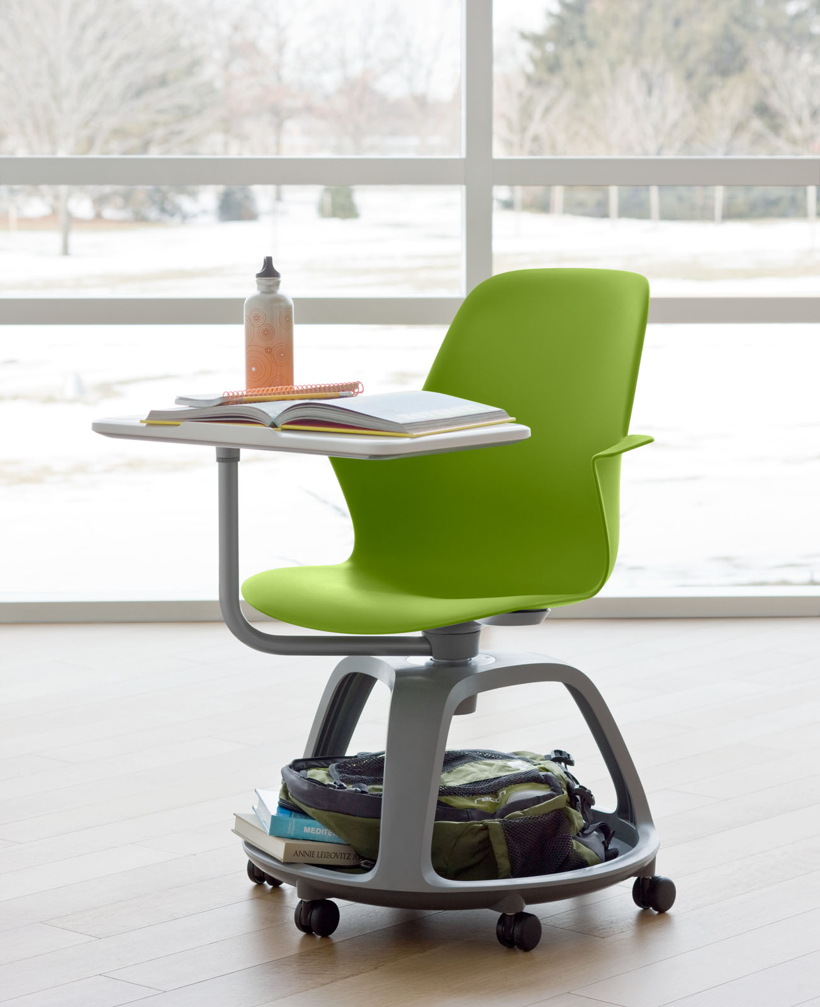
Hall of Fame
Name of system:
The Steelcase Node Desk
Purpose of system:
Active learning with mobility. Provides full desk table, under-seat storage and customizable to fit all size
Target user:
Left and Right handed users.
Children and adult to be used in schools, lectures, discussion or meetings.

Slide 3
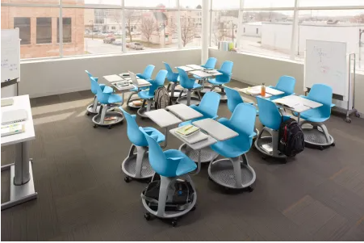
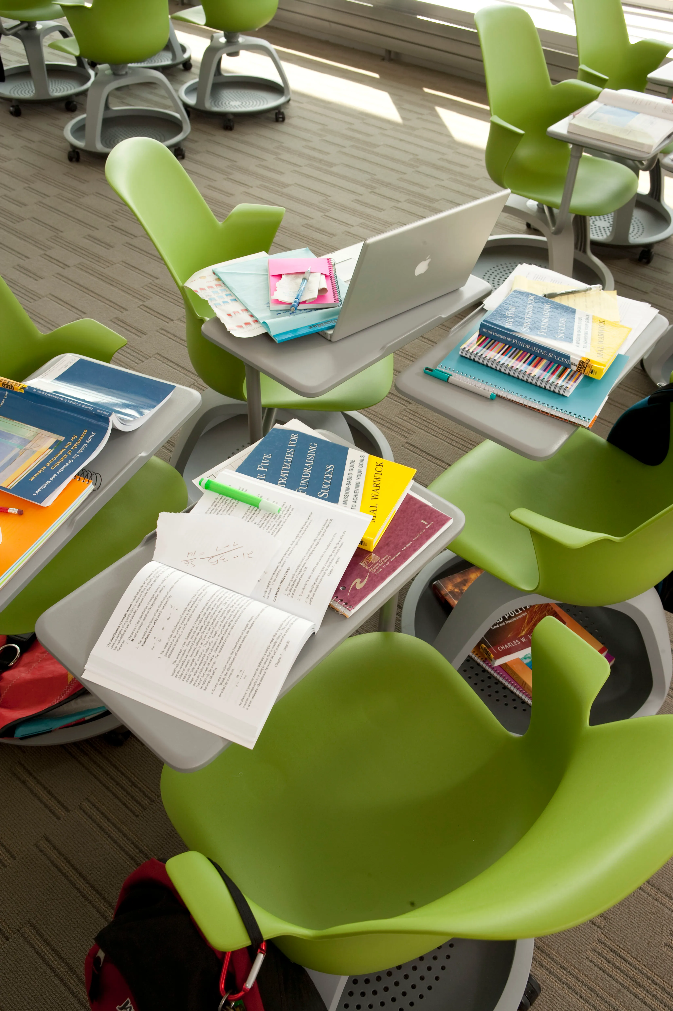
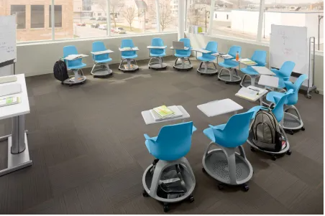
Usability analysis
Good points
[Learnability]:
As a left hander, it helps us to write better on a full desk and more pay attention to lectures or meetings in a comfortable position in order to accomplish our task better.
[Efficiency]:
Both left and right handed users are able to perform task equally at a much faster pace by having more work and writing surface to place materials beside each other.
[Flexibility]:
Able to customize for users of all shape and sizes.
https://firewireblog.com/2010/08/23/the-steelcase-node-desk/

Slide 4
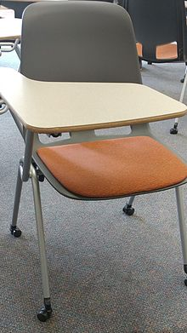
Hall of Shame
Name of system:
Right Handed Flip Desk
Purpose of system:
Promotes active learning with mobility
Target user:
Right handed users

Slide 5
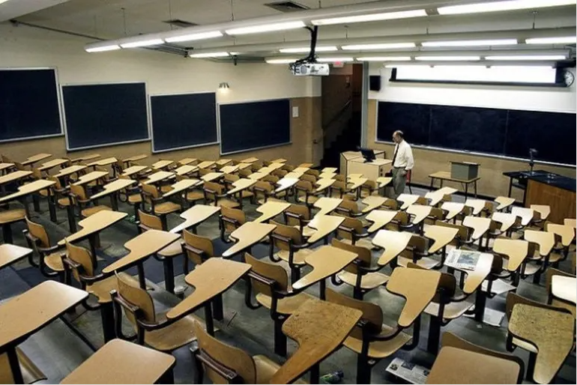
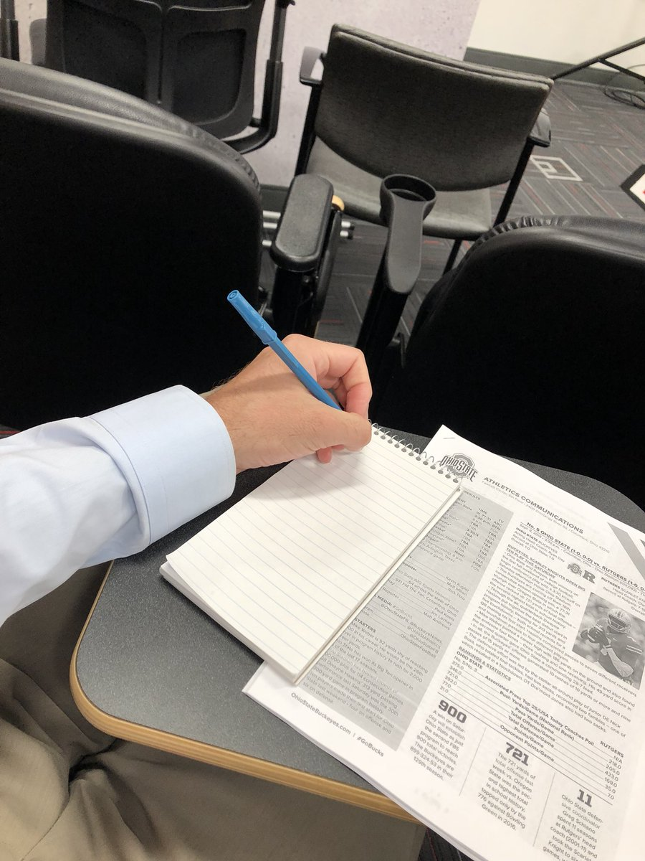
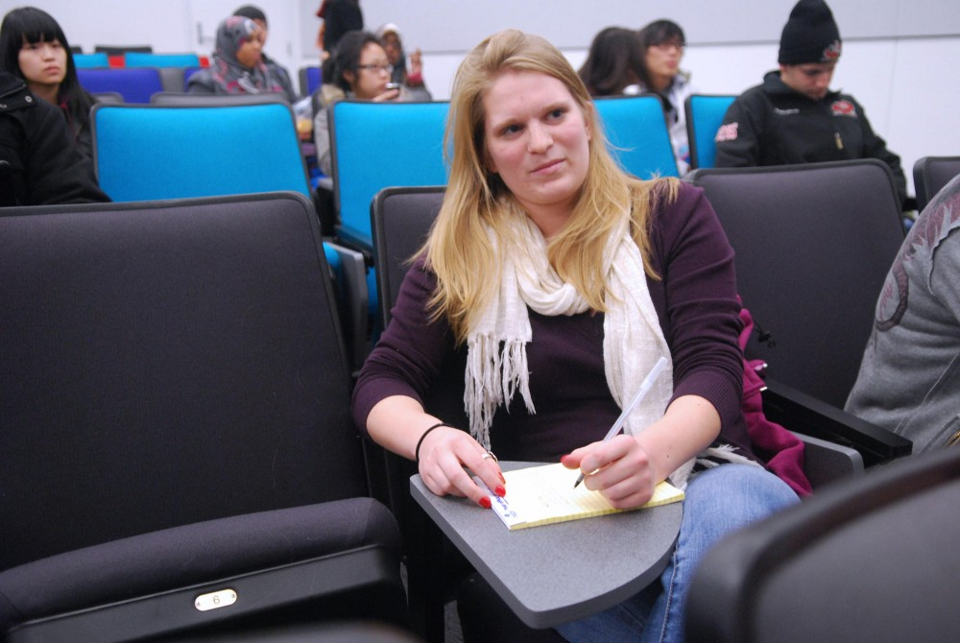
Usability analysis
Bad points
[Learnability]:
Left handers have to twist their body and face towards the right to write on right biased desk. Left handed users can experience back, shoulder, neck problems in a long run while accomplishing task.
[Efficiency]:
Inefficient and awkward writing position for left handers may cause them in slower writings, impacting learning abilities, medical conditions and be disadvantaged in timed test or examination such as accused as cheating.
[Flexibility]:
Flexible for users who are majority users who are right handed but does not apply well for minorities such as left hand users.
Not enough room space for laptops, textbooks, etc.
Does not fit everyone’s size.
You may add new slides if needed.

